Slide 1
Web Search and Mining
Lecture 14: Link Analysis

Slide 2
Outline
Anchor text
Link analysis for ranking
  PageRank and variants
  HITS

Slide 3
The Web as a Directed Graph
Anchor Text
Page A
Page B
hyperlink
Anchor
Assumption 1: A hyperlink between pages denotes author perceived relevance (quality signal)
Assumption 2: The text in the anchor of the hyperlink describes the target page (textual context)

Slide 4
Anchor Text
WWW Worm - McBryan [Mcbr94]
Anchor Text
For ibm how to distinguish between:
  IBM’s home page (mostly graphical)
  IBM’s copyright page (high term freq. for ‘ibm’)
  Rival’s spam page (arbitrarily high term freq.)
“ibm.com”
“IBM home page”
“ibm”
A million pieces of anchor text with “ibm” send a strong signal
www.ibm.com

Slide 5
Indexing anchor text
Anchor Text
When indexing a document D, include anchor text from links pointing to D.
Armonk, NY-based computer
giant IBM announced today
www.ibm.com
Big Blue today announced
record profits for the quarter
Joe’s computer hardware links
Sun
HP
IBM

Slide 6
Indexing anchor text
Anchor Text
Can sometimes have unexpected side effects - e.g., evil empire.
Can score anchor text with weight depending on the authority of the anchor page’s website
  E.g., if we were to assume that content from cnn.com or yahoo.com is authoritative, then trust the anchor text from them

Slide 7
Anchor Text
Anchor Text
Other applications
  Weighting/filtering links in the graph
  Generating page descriptions from anchor text

Slide 8
Citation Analysis

Slide 9
Citation Analysis
Citation frequency
Co-citation coupling frequency
  Cocitations with a given author measures “impact”
  Cocitation analysis
Bibliographic coupling frequency
  Articles that co-cite the same articles are related
Citation indexing
  Who is this author cited by? (Garfield 1972)
PageRank preview: Pinsker and Narin ’60s

Slide 10
Query-independent ordering
First generation: using link counts as simple measures of popularity.
Two basic suggestions:
  Undirected popularity:
    Each page gets a score = the number of in-links plus the number of out-links (3+2=5).
  Directed popularity:
    Score of a page = number of its in-links (3).

Slide 11
Query processing
First retrieve all pages meeting the text query (say venture capital).
Order these by their link popularity (either variant on the previous slide).
More nuanced – use link counts as a measure of static goodness, combined with text match score

Slide 12
Spamming simple popularity
Exercise: How do you spam each of the following heuristics so your page gets a high score?
  Each page gets a static score = the number of in-links plus the number of out-links.
  Static score of a page = number of its in-links.

Slide 13
PageRank

Slide 14
PageRank scoring
PageRank
Imagine a browser doing a random walk on web pages:
  Start at a random page
  At each step, go out of the current page along one of the links on that page, equiprobably
“In the steady state” each page has a long-term visit rate - use this as the page’s score.
1/3
1/3
1/3

Slide 15
Not quite enough
PageRank
The web is full of dead-ends.
  Random walk can get stuck in dead-ends.
  Makes no sense to talk about long-term visit rates.
??

Slide 16
Teleporting
PageRank
At a dead end, jump to a random web page.
At any non-dead end, with probability 10%, jump to a random web page.
  With remaining probability (90%), go out on a random link.
  10% - a parameter.

Slide 17
Result of teleporting
PageRank
Now cannot get stuck locally.
There is a long-term rate at which any page is visited (not obvious, will show this).
How do we compute this visit rate?

Slide 18
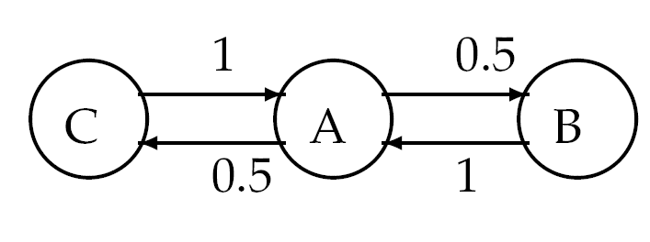
Markov chains
PageRank
A Markov chain consists of n states, plus an n×n transition probability matrix P.
At each step, we are in exactly one of the states.
For 1 ≤ i,j ≤ n, the matrix entry P_{ij} tells us the probability of j being the next state, given we are currently in state i.
P_{ii}>0 is OK.
i
j
P_{ij}

Slide 19
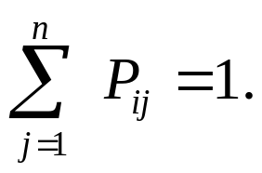
Markov chains
PageRank
Clearly, for all i,
Markov chains are abstractions of random walks.
Exercise: represent the teleporting random walk from 3 slides ago as a Markov chain, for this case:
A
B
C

Slide 20
Markov chains
To construct the transition probability matrix P
Assume the adjacency matrix is A. If a row of A has no 1’s, then set each element by 1/n.
    For all other rows proceed as follows: divide each 1 in A by the number of 1s in its row.
    Multiply the resulting matrix by (1-x)
    Add x/n to every entry of the resulting matrix, to obtain P.

Slide 21
Ergodic Markov chains
PageRank
A Markov chain is ergodic if
  you have a path from any state to any other
  For any start state, after a finite transient time T₀, the probability of being in any state at a fixed time T>T₀ is nonzero.
Not
ergodic
(even/
odd).

Slide 22
Ergodic Markov chains
PageRank
For any ergodic Markov chain, there is a unique long-term visit rate for each state.
  Steady-state probability distribution.
Over a long time-period, we visit each state in proportion to this rate.
It doesn’t matter where we start.

Slide 23
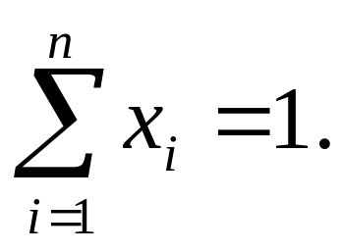
Probability vectors
PageRank
A probability (row) vector x = (x₁, … x_{n}) tells us where the walk is at any point.
E.g., (000…1…000) means we’re in state i.
1
i
n
More generally, the vector x = (x₁, … x_{n}) means the walk is in state i with probability x_{i}.

Slide 24
Change in probability vector
PageRank
If the probability vector is x = (x₁, … x_{n}) at this step, what is it at the next step?
Recall that row i of the transition prob. Matrix P tells us where we go next from state i.
So from x, our next state is distributed as xP.

Slide 25
Steady state example
PageRank
The steady state looks like a vector of probabilities a = (a₁, … a_{n}):
  a_{i} is the probability that we are in state i.
3/4
1/4
1
2
3/4
1/4
For this example, a₁=1/4 and a₂=3/4.

Slide 26
How do we compute this vector?
PageRank
Let a = (a₁, … a_{n}) denote the row vector of steady-state probabilities.
If our current position is described by a, then the next step is distributed as aP.
But a is the steady state, so a=aP.
Solving this matrix equation gives us a.
  So a is the (left) eigenvector for P.
  (Corresponds to the “principal” eigenvector of P with the largest eigenvalue.)
  Transition probability matrices always have largest eigenvalue 1.

Slide 27
One way of computing a
PageRank
Recall, regardless of where we start, we eventually reach the steady state a.
Start with any distribution (say x=(10…0)).
After one step, we’re at xP;
after two steps at xP² , then xP³ and so on.
“Eventually” means for “large” k, xP^{k} = a.
Algorithm: multiply x by increasing powers of P until the product looks stable.

Slide 28
PageRank summary
PageRank
Preprocessing:
  Given graph of links, build matrix P.
  From it compute a.
  The entry a_{i} is a number between 0 and 1: the PageRank of page i.
Query processing:
  Retrieve pages meeting query.
  Rank them by their PageRank.
  Order is query-independent.

Slide 29
The reality
PageRank
PageRank is used in google, but is hardly the full story of ranking
  Many sophisticated features are used
  Some address specific query classes
  Machine learned ranking heavily used
PageRank still very useful for things like crawl policy

Slide 30
PageRank: Issues and Variants
PageRank
How realistic is the random surfer model?
  (Does it matter?)
  What if we modeled the back button?
  Surfer behavior sharply skewed towards short paths
  Search engines, bookmarks & directories make jumps non-random.
Biased Surfer Models
  Weight edge traversal probabilities based on match with topic/query (non-uniform edge selection)
  Bias jumps to pages on topic (e.g., based on personal bookmarks & categories of interest)

Slide 31
Topic Specific PageRank
PageRank
Goal – pagerank values that depend on query topic
Conceptually, we use a random surfer who teleports, with say 10% probability, using the following rule:
    Selects a topic (say, one of the 16 top level ODP categories) based on a query & user -specific distribution over the categories
    Teleport to a page uniformly at random within the chosen topic
Sounds hard to implement: can’t compute PageRank at query time!

Slide 32
Topic Specific PageRank
PageRank
Offline:Compute PageRank for individual topics
  Query independent as before
  Each page has multiple PageRank scores – one for each ODP category, with teleportation only to that category
Online: Query context classified into (distribution of weights over) topics
  Generate a dynamic PageRank score for each page – weighted sum of topic-specific PageRanks

Slide 33
Influencing PageRank (“Personalization”)
PageRank
Input:
  Web graph W
  Influence vector v over topics
    v : (page → degree of influence)
Output:
  Rank vector r: (page → page importance wrt v)
r = PR(W , v)
Vector has one
component for
each topic
Notes:
basis
web graph!!

Slide 34
Non-uniform Teleportation
PageRank
Sports
Teleport with 10% probability to a Sports page

Slide 35
Interpretation of Composite Score
PageRank
Given a set of personalization vectors {v_{j}}
∑_{j} [w_{j} · PR(W , v_{j})] = PR(W , ∑_{j} [w_{j} · v_{j}])
Given a user’s preferences over topics, express as a combination of the “basis” vectors v_{j}

Slide 36
Interpretation
PageRank
Sports
10% Sports teleportation

Slide 37
Interpretation
PageRank
Health
10% Health teleportation

Slide 38
Interpretation
PageRank
Health
Sports
pr = (0.9 PR_{sports} + 0.1 PR_{health}) gives you:
9% sports teleportation, 1% health teleportation

Slide 39
Hyperlink-Induced Topic Search (HITS)

Slide 40
Hyperlink-Induced Topic Search (HITS)
HITS
In response to a query, instead of an ordered list of pages each meeting the query, find two sets of inter-related pages:
  Hub pages are good lists of links on a subject.
    e.g., “Bob’s list of cancer-related links.”
  Authority pages occur recurrently on good hubs for the subject.
Best suited for “broad topic” queries rather than for page-finding queries.
Gets at a broader slice of common opinion.

Slide 41
Hubs and Authorities
HITS
Thus, a good hub page for a topic points to many authoritative pages for that topic.
A good authority page for a topic is pointed to by many good hubs for that topic.
Circular definition - will turn this into an iterative computation.

Slide 42
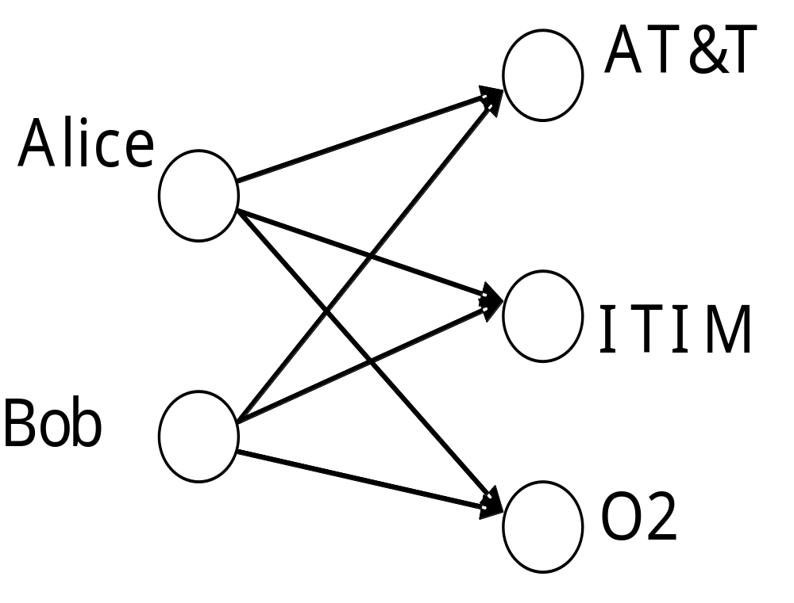
The hope
HITS
Authorities
Hubs
Mobile telecom companies

Slide 43
High-level scheme
HITS
Extract from the web a base set of pages that could be good hubs or authorities.
From these, identify a small set of top hub and authority pages;
  iterative algorithm.

Slide 44
Base set
HITS
Given text query (say browser), use a text index to get all pages containing browser.
  Call this the root set of pages.
Add in any page that either
  points to a page in the root set, or
  is pointed to by a page in the root set.
Call this the base set.

Slide 45
Visualization
HITS
Root
set
Base set

Slide 46
Assembling the base set
HITS
Root set typically 200-1000 nodes.
Base set may have thousands of nodes
  Topic-dependent
How do you find the base set nodes?
  Follow out-links by parsing root set pages.
  Get in-links (and out-links) from a connectivity server

Slide 47
Distilling hubs and authorities
HITS
Compute, for each page x in the base set, a hub score h(x) and an authority score a(x).
Initialize: for all x, h(x)←1; a(x) ←1;
Iteratively update all h(x), a(x);
After iterations
  output pages with highest h() scores as top hubs
  highest a() scores as top authorities.
Key

Slide 48
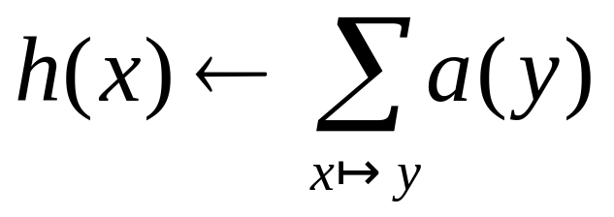
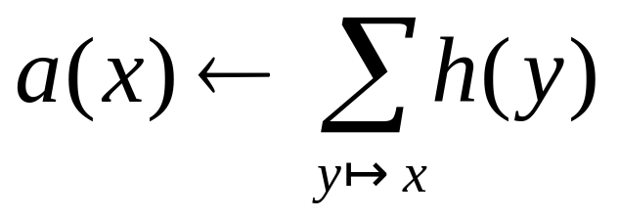
Iterative update
HITS
Repeat the following updates, for all x:
x
x

Slide 49
Scaling
HITS
To prevent the h() and a() values from getting too big, can scale down after each iteration.
Scaling factor doesn’t really matter:
  we only care about the relative values of the scores.

Slide 50
How many iterations?
HITS
Claim: relative values of scores will converge after a few iterations:
  in fact, suitably scaled, h() and a() scores settle into a steady state!
  proof of this comes later.
We only require the relative orders of the h() and a() scores - not their absolute values.
In practice, ~5 iterations get you close to stability.

Slide 51
Japan Elementary Schools
HITS
Hubs
Authorities
schools
LINK Page-13
“ú–{‚ÌŠwZ
a‰„¬ŠwZƒz[ƒƒy[ƒW
100 Schools Home Pages (English)
K-12 from Japan 10/...rnet and Education )
http://www...iglobe.ne.jp/~IKESAN
‚l‚f‚j¬ŠwZ‚U”N‚P‘g•¨Œê
ÒŠ—’¬—§ÒŠ—“Œ¬ŠwZ
Koulutus ja oppilaitokset
TOYODA HOMEPAGE
Education
Cay's Homepage(Japanese)
–y“ì¬ŠwZ‚Ìƒz[ƒƒy[ƒW
UNIVERSITY
‰J—³¬ŠwZ DRAGON97-TOP
Â‰ª¬ŠwZ‚T”N‚P‘gƒz[ƒƒy[ƒW
¶µ°é¼ÂÁ© ¥á¥Ë¥å¡¼ ¥á¥Ë¥å¡¼
The American School in Japan
The Link Page
‰ªès—§ˆä“c¬ŠwZƒz[ƒƒy[ƒW
Kids' Space
ˆÀés—§ˆÀé¼•”¬ŠwZ
‹{é‹³ˆç‘åŠw•‘®¬ŠwZ
KEIMEI GAKUEN Home Page ( Japanese )
Shiranuma Home Page
fuzoku-es.fukui-u.ac.jp
welcome to Miasa E&J school
_“ÞìŒ§E‰¡•ls—§’†ì¼¬ŠwZ‚Ìƒy
http://www...p/~m_maru/index.html
fukui haruyama-es HomePage
Torisu primary school
goo
Yakumo Elementary,Hokkaido,Japan
FUZOKU Home Page
Kamishibun Elementary School...

Slide 52
Things to note
HITS
Pulled together good pages regardless of language of page content.
Use only link analysis after base set assembled
  iterative scoring is query-independent.
Iterative computation after text index retrieval - significant overhead.

Slide 53
Proof of convergence
HITS
n×n adjacency matrix A:
  each of the n pages in the base set has a row and column in the matrix.
  Entry A_{ij} = 1 if page i links to page j, else = 0.
1 2 3
1
2
1
2
3
0 1 0
1 1 1
3
1 0 0

Slide 54
Hub/authority vectors
HITS
View the hub scores h() and the authority scores a() as vectors with n components.
Recall the iterative updates

Slide 55
Rewrite in matrix form
HITS
h=Aa.
a=A^{t}h.
Recall A^{t} is the transpose of A.
Substituting, h=AA^{t}h and a=A^{t}Aa.
Thus, h is an eigenvector of AA^{t} and a is an eigenvector of A^{t}A.
Further, our algorithm is a particular, known algorithm for computing eigenvectors: the power iteration method.
Guaranteed to converge.

Slide 56
Issues
HITS
Topic Drift
  Off-topic pages can cause off-topic “authorities” to be returned
    E.g., the neighborhood graph can be about a “super topic”
Mutually Reinforcing Affiliates
  Affiliated pages/sites can boost each others’ scores
    Linkage between affiliated pages is not a useful signal

Slide 57
Resources
IIR Chap 21
http://www2004.org/proceedings/docs/1p309.pdf
http://www2004.org/proceedings/docs/1p595.pdf
http://www2003.org/cdrom/papers/refereed/p270/kamvar-270-xhtml/index.html
http://www2003.org/cdrom/papers/refereed/p641/xhtml/p641-mccurley.html

